Slide 1


COZY
WAVE
Submitted to: Mr. Yasir Nisar
PG-10
Aditya Singh Aswal(2310990098)
Anuj Maurya(231991615)
Dhanur Rehlan(2310991647)

Slide 2

About the project
Cozy Wave enhances hospitality with innovation, focusing on guest comfort, sustainability, and technology.

Slide 3

Innovation?
Developed an online booking platform using Express, Node.js, and EJS for secure and efficient reservation management.
Integrated five essential middlewares: request validation, centralized error handling, token-based authentication, request logging, and JSON/body data parsing.

Slide 4

Day to Day Application
Digital registration systems to streamline processes.
Online service bookings for accommodations of both hotels and resorts together
Sustainable practices such as energy conservation and waste reduction.

Slide 5
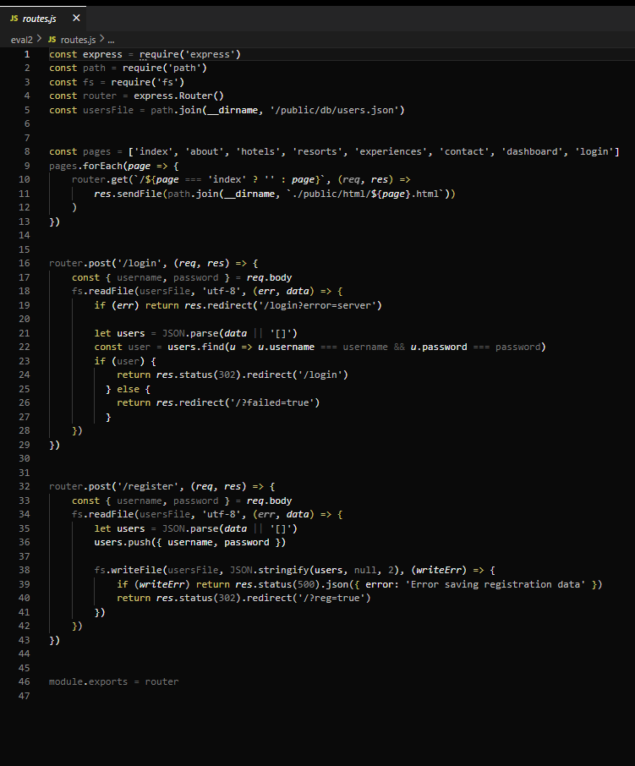
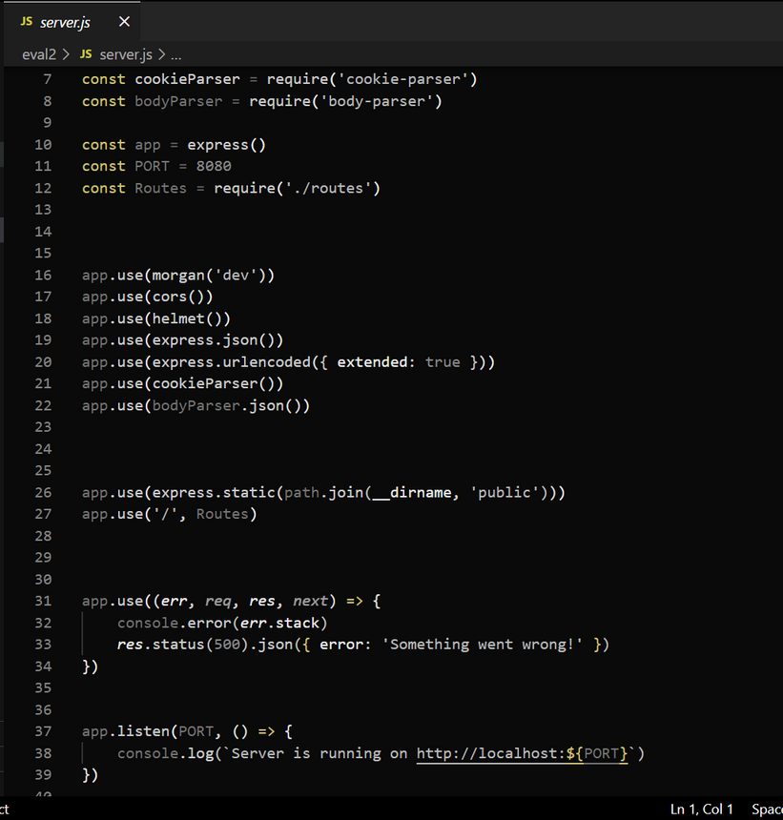
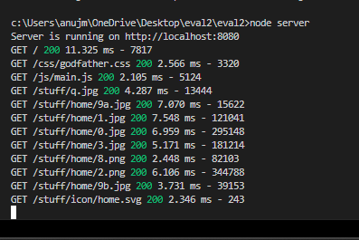


Snapshots

Slide 6

References
Class Notes
Express Js documentation:https://expressjs.com/
Node Js documention: https://nodejs.org/en/
Google drive link: https://shorturl.at/HsPMg

Slide 7

Thank
You

